Slide 1
Geo 318 – Introduction to GIS Programming
Dr. Jim Graham

Slide 2
Introductions
What is your name?
What is your major?
What do you want to do for your career?

Slide 3
Why are you here?
You’re paying about $1500 for this class, $50 per lecture/lab
Why?

Slide 4
Why Program?
Automate tasks
  Repeated over and over again
Speed up tasks
  Computers can run 24/7
Allows for “exact” replication of processes
  Except that the libraries you call will change!
“Encapsulate” functionality and expertise
  You and everyone else can use it

Slide 5
To be successful
Are on time and attend every session you possibly can be.
If you can't make a session, let me know why.
Start assignments when they are given and then finish them before they are due. This allows you to get help when needed.
Turn in all assignments BEFORE they are due.
Spend time programming!

Slide 6
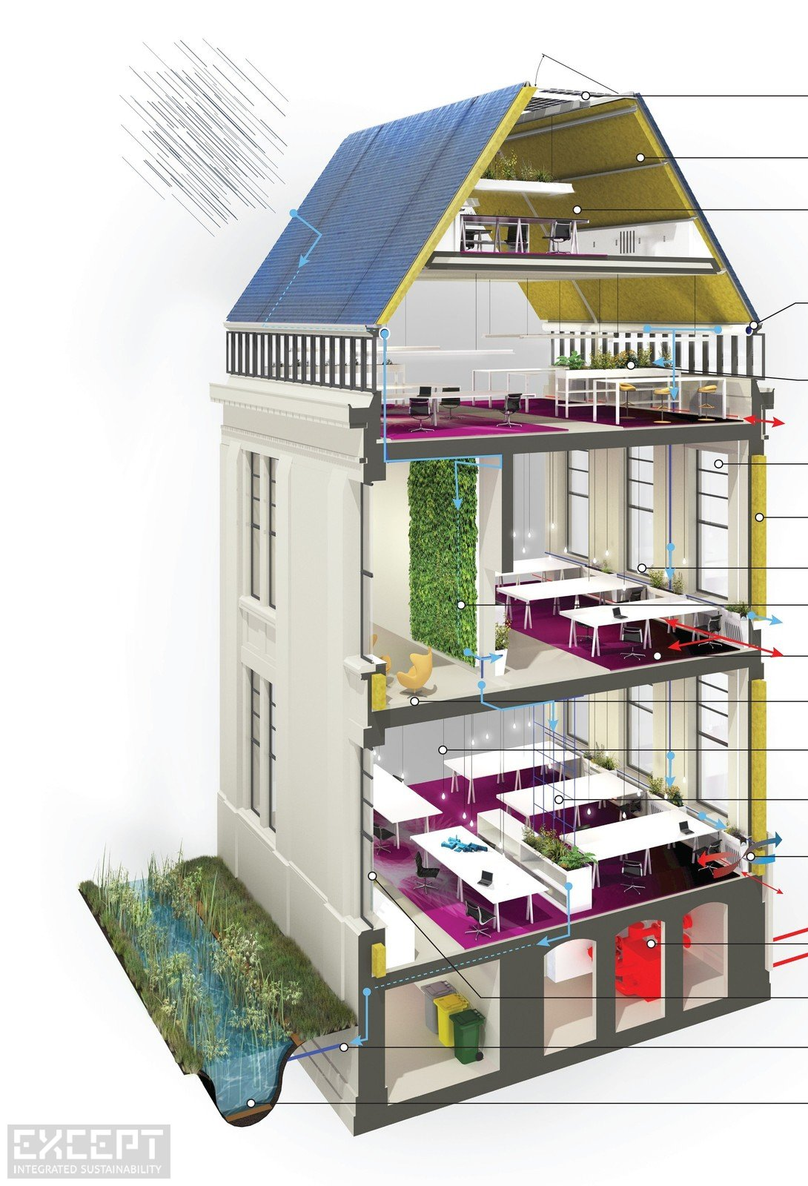
Programming Builds on Itself
Design
Classes
Modules
Testing
File access
Functions
Testing
Lists / Arrays
Loops
Conditional Statements
Mathematics
Data Types
Comments

Slide 7
Class Goals
Focus: Geospatial Programming
How computers work
  How to program & debug code
  How to tackle geospatial programming tasks
Python
  By itself
  With ArcGIS
  With other software
Software development
  Documentation
  Management/Phases
  Meeting users NEEDS

Slide 8
We are not learning…
Everything about Python
  It’s a huge language that is growing all the time!
  You only need a fraction of what is out there
  The challenge is to find that fraction and get good at it!
Everything about programming ArcGIS
  You will learn how to find anything available in programming ArcGIS
Everything about programming GIS
  More on this later…

Slide 9
We are learning…
Everything you need to figure out how to solve any programming problem in GIS that can be solved!
  Programming
  Debugging
  Finding answers
  Getting help
  Introduction to the larger world of software development

Slide 10
To be Successful
Types of learning:
  Knowledge and concepts
    Review the material on the website
    Take notes and review them!
  Skills
    The only way to learn to ride a bike is to get on one
    The only way to learn to program is to do it
    7 hours outside of class per week at least!
  Communication and Teamwork
    Teams of 3-4 throughout the semester

Slide 11
Learning Process
Read & practice material on web site
  Quizzes encourage reading and let me know if topics are sinking in
Interactive lectures on critical and sticky areas
  Take notes in your notebook
Start assignments early
  “Play” until comfortable with the material
Turn in what you have! (including comments)
Repeat from 1

Slide 12
Structure (con’t)
Canvas for assignments
  Weekly homework -> Final project
Website for weekly content
Google Group for group communication
Teams of 1-2
There is no book but the web is full of great (and terrible) resources

Slide 13
Resources for Help
ArcGIS help – best for Arc libraries
The Web – search for answers
ListServs – including Canvas blogs
Your team
Me and the tutors
Others?
  Anyone you can find who might have dealt with the same problem!

Slide 14

Previously, 10% did not pass!
If you fall behind in this class you will not pass!
  Each week we learn concepts that are used the next week
  We move together as a whole group
Attendance is mandatory
  If you miss a class, make sure you catch up and get assignments in
Assignments must be in on time
  If you fall behind you’ll be working on the wrong assignment

Slide 15
Grading
Assignments
Quizzes
Final Project

Slide 16
Keep Up with the Pack!
This class moves!
  I’ll introduce a new topic and then you’ll have time to practice and work on the assignment
  This is a skills class, not everything you need to know is online – you’ll need to attend classes
Turn in labs each week
  Complete assignments outside of class and then turn in whatever you have when it is due
Get help when you need it!
  If you get stuck for 20 minutes, get help!

Slide 17
Final Projects
GIS Programming Problem
Must include some code you have written
Must apply to a GIS application
Class is 15 weeks – don’t build a biomass model for the earth!
Start getting the data now!

Slide 18
Examples
Harvest tree ring data to create a map in GoogleEarth with growth charts
Program to compute likely camping sites in wilderness areas
Program to mosaic Landsat scenes for anywhere in US
Simulation of werewolves chasing people
Kiosk using RaspberryPi

Slide 19
Professionalism
Right now you are all like new employees
  Note: I may be a reference for a future job
Show up on time and stay throughout class
Participate in discussions
Complete assignments on time
Help your class mates
Talking while someone else “has the floor”
See the “7 habits”

Slide 20
Repeating Problems
Practice programming (not just copy from other students or the web)
Start early (program some each day)
Not showing up or dropping out rather then getting help
How can we minimize these and other problems?
  Please meet in groups of four and then have one person add your groups ideas to the board

Slide 21
To Be Successful
Attend class and lab
Start assignments when assigned and turn them in before they are due
Take notes
Practice the stuff that is hard
Get help!

Slide 22

Ready to become a NERD?
Learn a bunch of new terms (mostly TLAs)
Think like a computer
Amaze (and confuse) your friends!
Get a whole new wardrobe!

Slide 23
Definitions
Code – Instructions for a computer
Programming/Coding – writing, documenting, and testing code
Program – A file with instructions for a computer to execute to complete a task
Application – A program with a graphic user interface (as opposed to a command line interface)
Library – A file with code for a computer to be used by other programs

Slide 24
Big Picture
ArcGIS Desktop
Wing IDE
Other Programs
Model Builder
Python Scripts
ArcGIS Libraries
Other Libraries
Data
Data includes GIS (spatially referenced) and non-spatially reference

Slide 25
Why Python?
ESRI’s primary scripting language (for now)
Very popular in GIS (Arc and OpenSource)
Very flexible (can solve lots of problems)
Well supported (with Wing IDE)
Easy to learn (relative to complied languages)
Portable
But it is not the fastest language
  Compiled (C/C++, Java, C#) are faster

